Slide 1

Interpreting Predictions from Complex Models
Scott Lundberg, Su-In Lee
University of Washington
San Francisco | November 2nd – 4th, 2017
Notes:
I am going to start with motivation, then get technical and mathy for a bit, then we will finish up with lots of practical examples.

Slide 2
Motivation
Math and intution
Examples
Notes:
I am going to start with motivation, then get technical and mathy for a bit, then we will finish up with lots of practical examples.

Slide 3
Sample problem: Filtering loan applications
chance they will repay loan
model
?
Susan, a bank customer

Slide 4
What kind of model will make the most $$?
Typically 2 winning approaches in Kaggle:
Tree ensembles for structured data (hand crafted features)
Neural networks for unstructured data (images, speech, etc.)
Notes:
While there are a huge variety of model to choose from, in practice either deep learning or tree ensembles usually win the day for accuracy. And our bank’s bottom line depends on our accuracy.

Slide 5
The bank has structured data
Capital losses | $0
Weekly hours | 40
Occupation | Protective-serv
Capital gains | $0
Age | 28
Marital status | Married-civ-spouse
chance they will repay loan
model
?

Slide 6
So we use a tree ensemble
Capital losses | $0
Weekly hours | 40
Occupation | Protective-serv
Capital gains | $0
Age | 28
Marital status | Married-civ-spouse
chance they will repay loan
XGBoost
31%
No loan
Why did Susan’s loan get denied?!

Slide 7
Problem: Explaining complex models is hard!
 | Interpretable | Accurate
Complex model | ✘ | ✔
Simple model | ✔ | ✘
Interpretable, accurate: choose one.
😀 ⚖️
💰

Slide 8
Let’s see what features are important
xgboost_model.get_score()
Age

Slide 9
What about coverage instead split counts?
xgboost_model.get_score(importance_type=“cover”)
Occupation

Slide 10
What about ‘gain’ (reduction in training loss)?
xgboost_model.get_score(importance_type=“gain”)
Marital status

Slide 11
Idea: Don’t explain the whole model, just one prediction
Input value
Output value
Complex models are inherently complex!
But a single prediction involves only a small piece of that complexity.
Notes:
Explain that this is one feature input, don’t mention approximating with simpler model yet

Slide 12
Just use path expectations…
xgboost_model.predict(susan_data, pred_contribs=True)
Measures the impact of a feature as the change in expected model output, when splitting on that feature.
Notes:
Mention they have seen this figure before. Erase small text

Slide 13
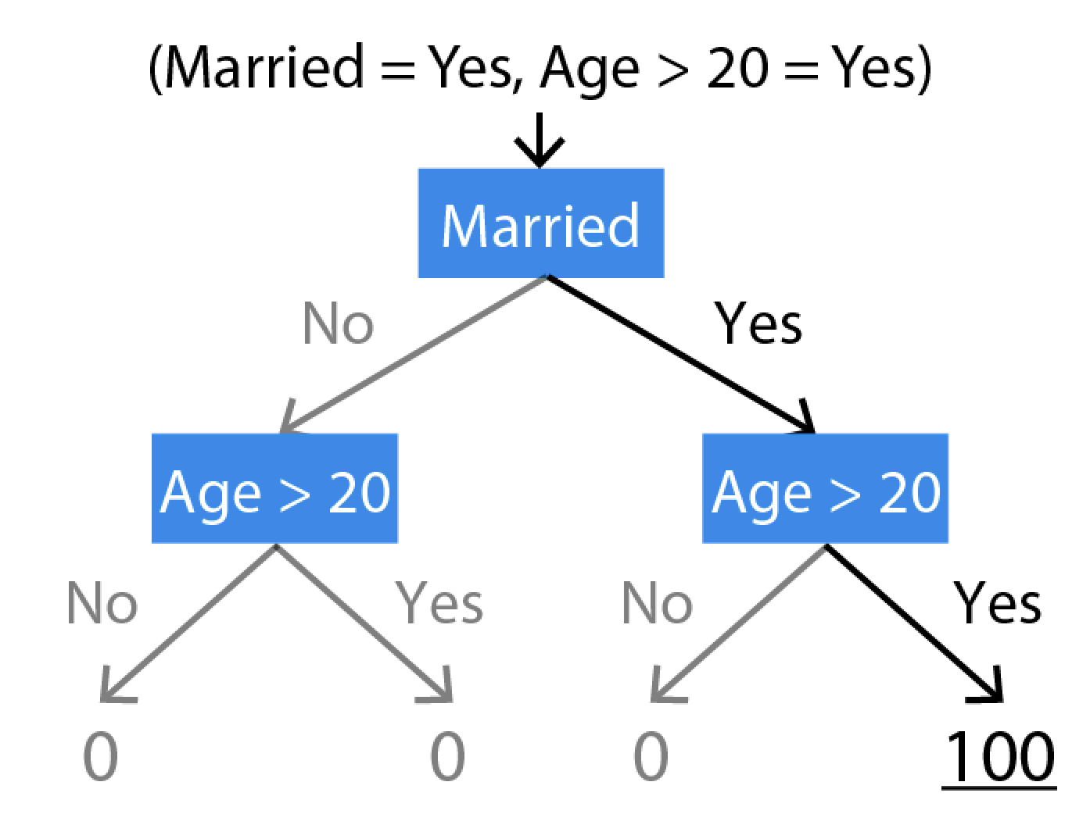
f(x) = [Married & Age > 20]*100
E[f(x)] = 25
Married: 50 - 25 = 25
Age > 20: 100 - 50 = 50
E[f(x) | Married ] = 50
E[f(x) | Married, Age > 20 ] = 100
Notes:
Here is an example of how the current XGBoost feature importances are calculated for an AND function. For this example we assume the cover of each leaf is equal, in other words an equal number of training points fall in each leaf. To explain a prediction, we start at the root where the expected value is 25, then follow the path taken by this example, noting how the expected value of the tree’s output changes. Unfortunately we see that the two features are given unequal credit, and even worse, the feature split on first gets the least credit.

Slide 14
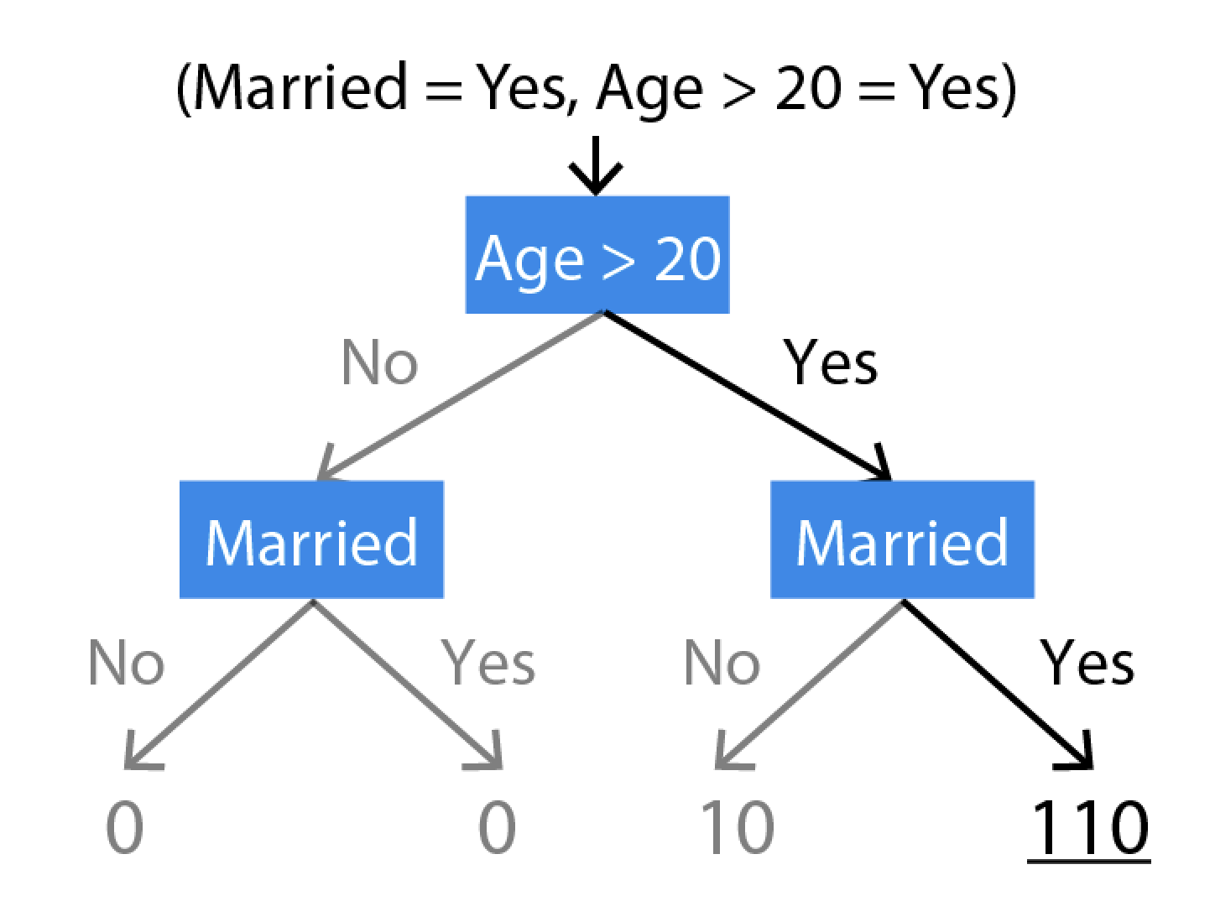
f(x) = [Married & Age > 20]*100 + [Age > 20]*10
E[f(x)] = 30
Married: 110 - 60 = 50
Age > 20: 60 - 30 = 30
E[f(x) | Age > 20 ] = 60
E[f(x) | Age > 20 , Married] = 110
Notes:
While uneven credit for an AND function is bad, even worse is that another similar function where “Age > 20” is clearly more important, actually places less weight on “Age > 20” . This is “inconsistency” where increasing the importances of a feature can actually decrease it’s assigned credit.

Slide 15
Nothing seems to do exactly want we want… …what do we want?
Notes:
While uneven credit for an AND function is bad, even worse is that another similar function where “Age > 20” is clearly more important, actually places less weight on “Age > 20” . This is “inconsistency” where increasing the importances of a feature can actually decrease it’s assigned credit.

Slide 16
Goal: Model agnostic interpretability
data
model
prediction
magic
explanation
What if we could view the model as a black box…
…and yet still be able to explain predictions?
Interpretable, accurate: choose two!
😀 ⚖️
💰

Slide 17
Some notation…
data
model
prediction
magic
explanation

Slide 18
Some notation…
x
model
prediction
magic
explanation

Slide 19
Some notation…
x
f
prediction
magic
explanation

Slide 20
Some notation…
x
f
f(x)
magic
explanation

Slide 21
Some notation…
x
f
f(x)
magic
g

Slide 22
What is an explanation anyway?
x
f
f(x)
magic
g
It is an interpretable function that approximates the behavior of f.
In other words…it’s a model.
Notes:
Ask audience what kind of mathematical entity is an explanation?

Slide 23
What is an explanation anyway?
Original model
x
f
f(x)
magic
g
Explanation method
Explanation model
Notes:
Ask audience what kind of mathematical entity is an explanation?

Slide 24
Every explanation method has an explanation model
Original model
x
f
f(x)
magic
g
Explanation method
Explanation model
We can group explanation methods into different classes by the types of explanation models they produce.

Slide 25
Simplified explanation model inputs
Original model
x
f
f(x)
magic
g
Explanation method
Explanation model
Input in simplified space
Simplified input space mapping

Slide 26
Local approximations
x
f
f(x)
magic
g

Slide 27
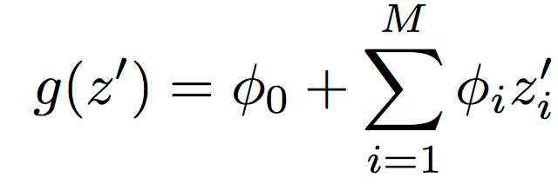

Class of additive feature attribution methods
Additive feature attribution methods have an explanation model that is a linear function of binary variables:

Slide 28
The additive feature attribution class is large
LIME
Approximate the complex model near a given prediction. - Ribeiro et al. 2016
Model agnostic
Shapley value sampling /
Quantitative Input Influence
Feature importance for a given prediction using game theory. - Štrumbelj et al 2014, Datta et al. 2016
Layer-wise relevance prop
Back propagates neural network explanations. - Bach et al. 2015
Neural networks
DeepLIFT
Difference from a reference explanations of neural networks. – Shrikumar et al. 2016
Shapley regression values
Explain linear models in the presence of collinearity. – Gromping et al. 2012
Linear
Path expectations
Change in expected output as we descend a tree. – Saabas 2014
Trees

Slide 29
Surprise: There is only one solution in this class with three desirable properties!
Local accuracy – The explanation model matches the original model for, x, the current input vector.
Missingness – Simplified inputs that are zero for the current input should be attributed no value.
Consistency – If you change the original model to vary more when an interpretable input changes from 0 to 1, then that input’s attribution should not decrease.
Notes:
Shorten all the text blurbs

Slide 30
SHapley Additive exPlanation (SHAP) values
Use Shapley values to measure the impact of a feature as the change in expected model output, when conditioning on that feature.
The order matters! SHAP values average over all N! possible orderings.
Notes:
Mention they have seen this figure before. Erase small text

Slide 31

The LIME formalism of fitting a simple interpretable model to a complex model locally
The loss function forcing g to well approximate f
Optional regularization of g
Kernel specifying what ‘local’ means
A class of interpretable models
But how do we pick 𝒢, L, $Ω$, and $π_{x′}$?

Slide 32

If 𝒢 is linear models, and x’ is binary then we are in the SHAP class!
This means the Shapley values are the only possible solution satisfying efficiency and monotonicity.
Great! But what about the parameters L, $Ω$, and $π_{x′}$?
Notes:
Make title shorter

Slide 33
The Shapley kernel
We found a kernel and loss function that cause a local approximation to reproduce the Shapley values.
There is no other kernel that satisfies the axioms and produces a different result.
Notes:
Be better about explaining why the symmetry is good.

Slide 34
Leads to improved consistency with human intuition
Fever & Cough = 2
Fever XOR Cough = 5
Not fever or cough = 0
Notes:
Make title shorter

Slide 35
Better identifies pixels that discriminate between classes
Notes:
Make title shorter

Slide 36
SHAP values for Susan’s loan application
Capital losses | $0
Weekly hours | 40
Occupation | Protective-serv
Capital gains | $0
Age | 28
Marital status | Married-civ-spouse
chance they will repay loan
model
31%

Slide 37
Base rate
26%
Model prediction
31%
chance they will repay loan
15%
40%
How did we get here?
Notes:
Mention they have seen this figure before. Erase small text

Slide 38
Occupation | Exec-managerial
Age | 37
Relationship | Wife
Years in school | 14
Sex | Female
Marital status | Married-civ-spouse
chance they will repay loan
No attributes are given to the model
model
26%
Base rate

Slide 39
Capital losses | $0
Weekly hours | 40
Occupation | Protective-serv
Capital losses | $0
Age | 28
Marital status | Married-civ-spouse
chance they will repay loan
model
25%

Slide 40
Model prediction if we only know they had no capital losses
25%
Base rate
26%
chance they will repay loan
15%
40%
No capital losses
Notes:
Mention they have seen this figure before. Erase small text

Slide 41
Prediction if we know they had no capital losses and work in police/fire
24%
Base rate
26%
chance they will repay loan
15%
40%
Police/fire
Notes:
Mention they have seen this figure before. Erase small text

Slide 42
Base rate
26%
chance they will repay loan
15%
40%
Work 40 hr/week
Notes:
Mention they have seen this figure before. Erase small text

Slide 43
Base rate
26%
chance they will repay loan
15%
40%
No capital gains
Notes:
Mention they have seen this figure before. Erase small text

Slide 44
Base rate
26%
chance they will repay loan
15%
40%
Age (no effect)
Notes:
Mention they have seen this figure before. Erase small text

Slide 45
Base rate
26%
chance they will repay loan
15%
40%
Married
Notes:
Mention they have seen this figure before. Erase small text

Slide 46
Base rate
26%
chance they will repay loan
15%
40%
Notes:
Mention they have seen this figure before. Erase small text

Slide 47
Base rate
26%
chance they will repay loan
15%
40%
Notes:
Mention they have seen this figure before. Erase small text

Slide 48
Base rate
26%
chance they will repay loan
15%
40%
Married
No capital
gains
P/F
Cap loss
40
Notes:
Mention they have seen this figure before. Erase small text

Slide 49
chance of making > $50K annually
15%
40%
Notes:
Mention they have seen this figure before. Erase small text

Slide 50
Notes:
Mention they have seen this figure before. Erase small text

Slide 51
Supervised clustering
Samples clustered by explanation similarity

Slide 52
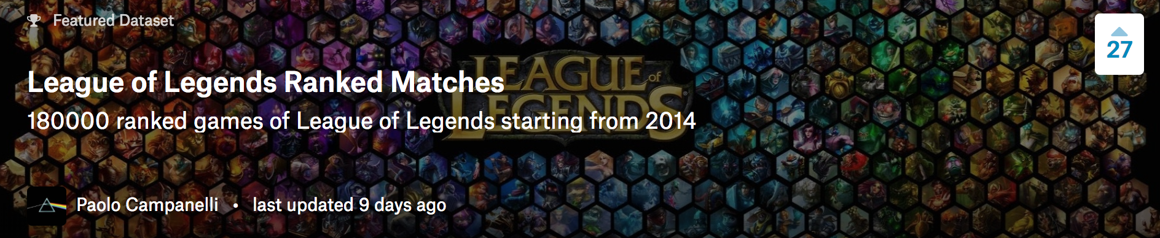
180,000 ranked games since 2014
Train an XGBoost model to predict from if a player won the game from their stats.
Train an XGBoost model to predict if a player won the game from their stats.
Use our fast new Tree SHAP algorithm now in XGBoost and LightGBM.
Notes:
Shorten all the text blurbs

Slide 53
Log odds vs. probability
Notes:
Shorten all the text blurbs

Slide 54
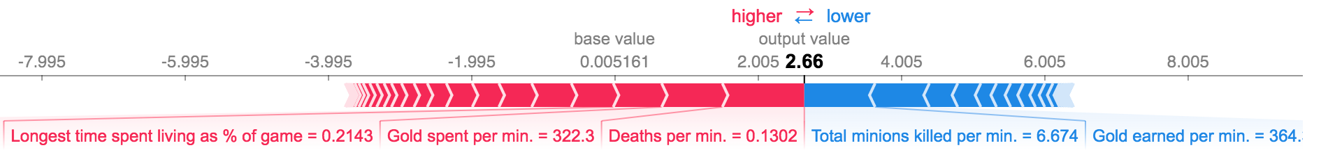
Explain a prediction for a single player
shap_values = model.predict(dv, pred_contribs=True)
shap.visualize(shap_values[0,:], feature_names=feature_names, data=Xv.iloc[0,:])
Notes:
Shorten all the text blurbs

Slide 55
Plot the impact of gold on all predictions
shap.plot(X[:,i], shap_values[:,i], “Gold earned per min.”, alpha=0.01)
Notes:
Shorten all the text blurbs

Slide 56
Plot the impact of death on all predictions
shap.plot(X[:,i], shap_values[:,i], “Deaths per min.”, alpha=0.01)
Notes:
Shorten all the text blurbs

Slide 57
Plot the impact of death on all predictions
shap.plot(X[:,i], shap_values[:,i], “Assists per min.”, alpha=0.01)
Notes:
Shorten all the text blurbs

Slide 58
Summarize the most important features
shap.summary_plot(shap_values, feature_names, max_display=10)
Notes:
Shorten all the text blurbs

Slide 59
Plot the impact of gold on all predictions
shap.interaction_plot(gind, Xv, shap_values, feature_names=names, alpha=0.01)
Notes:
Shorten all the text blurbs

Slide 60
Plot the impact of deaths on all predictions
shap.interaction_plot(gind, Xv, shap_values, feature_names=names, alpha=0.01)
Notes:
Shorten all the text blurbs

Slide 61
Plot the impact of assists on all predictions
shap.interaction_plot(gind, Xv, shap_values, feature_names=names, alpha=0.01)
Notes:
Shorten all the text blurbs

Slide 62
Plot the impact of minons killed
shap.interaction_plot(gind, Xv, shap_values, feature_names=names, alpha=0.01)
Notes:
Shorten all the text blurbs

Slide 63
Plot the impact of # turret kills
shap.interaction_plot(gind, Xv, shap_values, feature_names=names, alpha=0.01)
Notes:
Shorten all the text blurbs

Slide 64
Plot the impact of champion level
Notes:
Shorten all the text blurbs

Slide 65
Practical summary
When you explain something, ask yourself what explanation model you are using
SHAP values represent a theoretically grounded additive feature attribution solution.
Always ask why!
Notes:
Shorten all the text blurbs

Slide 66
How to do this yourself
https://github.com/slundberg/shap
Model agnostic requires hundreds or thousands of model evaluations per explanation.
Tree SHAP in XGBoost and LightGBM is exact and very fast. …if you use these models, then use SHAP ;)
Notes:
Mention that DeepLIFT is improved with SHAP insights, the LIME exponential kernels can be swapped for the Shapley kernel. Integrated gradients from Google follows from similar theoretical properties but for different explanation model type (i.e. different class).

